Slide 1

HR MIDDLE MANAGEMENT OPERATING COSTS AND PAYROLL EXPENSES ANALYSIS EXECUTIVE SUMMARY FOR XYZ Inc.
Prepared by Chibuzo Oha

Slide 2
BUSINESS REQUIREMENTS
XYZ's Leadership is concerned that the company's middle management (Management Bands 1-3) has grown disproportionately, causing increased operating costs and payroll expenses. The HR Operations team is creating an executive summary
to present to the Executives with the following detail:
1. Analysis validating / disproving their above-mentioned concerns
2. Clear insights on areas of concern (if any)
Headcount growth forecast over the next 5 years (assuming no changes in existing conditions)

Slide 3
DATA CLEANING, ASSUMPTIONS, and STEPS
Data Cleaning
Profiled the given data
Removed duplicate on the various tables
Removed null rows and spaces in between words e.g Economist R 24
Assumptions
Currency taken as USD
Replaced Economist R 24 with Economist R24 on job code 505101 and deleted the duplicate
Replace the Annual salary of 7689.99 on Job code 185001 with 76899.98 deleted the duplicate
Steps
Created a dynamic date table that spans to 2030.
Created column called Band to have two groups: Others and Band 1-3 from Job Grouping level 1
Merged salary table into employee information table

Slide 4
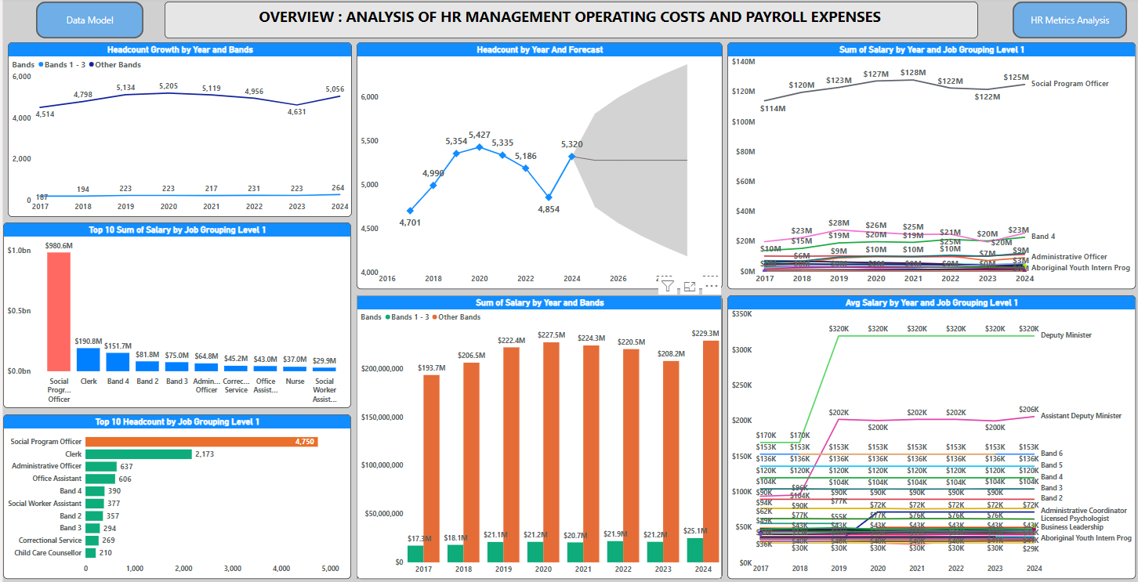
OVERVIEW:ANALYSIS OF HR MIDDLE MANAGEMENT OPERATING COSTS AND PAYROLL EXPENSES

Slide 5
INSIGHTS|PBIX VISUAL
Based on the insights, the compelling story is that Bands 1-3 are not responsible for the increase in operating costs and payroll expenses, disproving the notion that these bands have grown disproportionately and are causing higher costs.
My first concern is that there is a sharp increase in cost from 2018 to 2019, jumping from $170,000 to $320,000 for the Deputy Minister, representing almost a 200% increase, and from $95,700 to $202,099 for the Assistant Deputy Minister, which is above a 200% increase in cost. This is based on the visual “Avg Salary by Year and Job Grouping Level 1”.
My second concern is that the headcount in the “Head Count by Job Grouping Level 1” visual, reveals that the Social Program Officer has 4,750 followed by Clerk with 2,173. There is a need to investigate why we have such a huge number.
Based on the visual “Headcount by Year” trend analysis, in 2029 which is 5 years from now, we will have a head count of 5,277 with an upper band of 6,372 and lower band of 4,181, meaning the headcount can swing within the lower and upper band values in the next 5 years.

